Slide 1
Chromosome abnormalities detected at prenatal diagnosis

Slide 2
When a chromosomal abnormality is discovered, it is necessary to discuss in detail with the couple the implications of this particular abnormality, and to help them decide on a suitable course of action
In transmitting the information, the counselor is obliged to be clear and accurate about the particular abnormality and to take care that the couple’s autonomy in the decision-making process is not compromised
A decision for or against termination is the immediate one to be made
Factors usually influencing parents’ decision:
their philosophy of life
their religious views
their socioeconomic status
whether this was a first or wanted pregnancy or a later, unplanned pregnancy

Slide 3
Mosaicism: confined, constitutional, and pseudo
Most times, mosaicism in villus tissue or amniocytes does not reflect a true constitutional mosaicism of the embryo
Three categories:
Confined placental mosaicism CPM, a chromosomally abnormal cell line may exist only in the extra- embryonic tissues of the placenta (chorion, amnion), and the embryo is 46,N
True constitutional fetal mosaicism
Pseudomosaism, an abnormality that arose during tissue culture in vitro
CPM is encountered at CVS rather than at amniocentesis

Slide 4
It is uncommon that an observation of apparent CPM at CVS reflects a true constitutional mosaicism of the fetus
A study of ~50,000 CVS procedures, mosaicism was seen in 2.2%, of these only 13% (0.3% of the total) proved to have a true fetal mosaicism

Slide 5
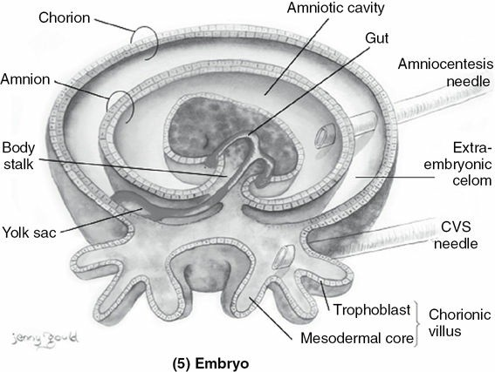
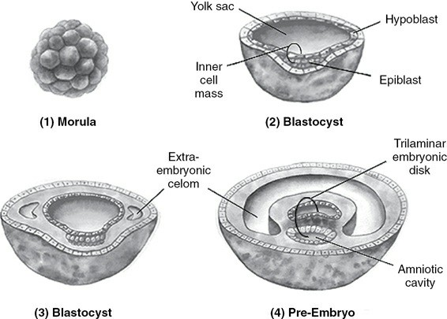
FIGURE 21–1 Developmental origins of tissues sampled at prenatal diagnosis

Slide 6
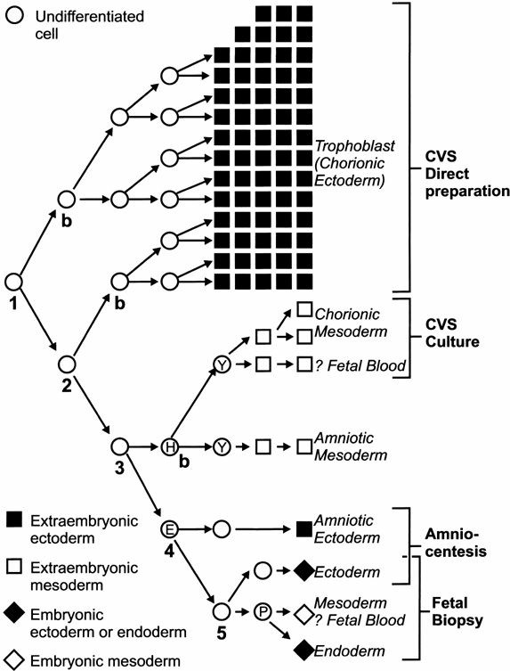
FIGURE 21–3 Diagram of cell lineages arising from differentiation in the very early conceptus
Amniocentesis samples cells having origin from the epiblast of the inner cell mass, these cells rather closely reflect the true constitution of the embryo
Chorionic villus sampling, samples more distantly related cells: trophoblast cells (direct and short-term culture), which were the first lineage to differentiate from totipotent cells of the morula, and villus core cells (long-term culture), which reflect the more recently separated lineage of the extra- embryonic mesoderm.
Noninvasive prenatal testing, samples cell-free DNA that originated from apoptotic trophoblast cells, and therefore is more closely related to CVS than to amniocentesis
E, epiblast
H, hypoblast
P, primitive streak
Y, yolk sac

Slide 7
Mechanisms of Mosaicism
Distribution of the normal and abnormal cell lines in fetus and placenta depends upon time and place of the abnormal mitotic event
If a trisomic conceptus is “rescued” by the generation of a normal cell line, at a very early stage, in a cell that is going to give rise to the inner cell mass and to some of the extrafetal tissues, then the embryo may be 46,N, and the placenta will show mosaic trisomy
If rescue occurred at a later stage, the placenta might be entirely trisomic, with a mosaic trisomy of the fetus

Slide 8
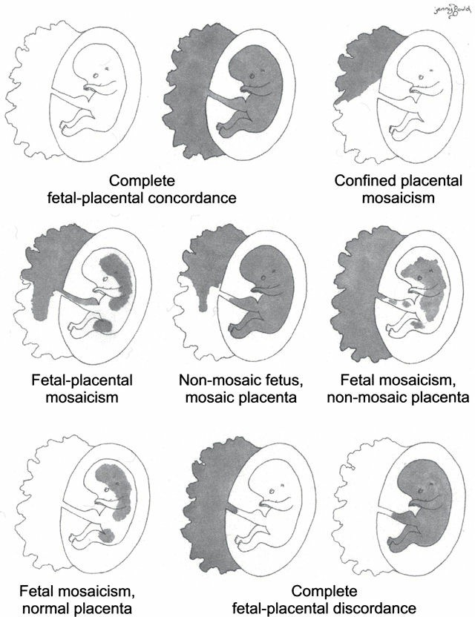
FIGURE 21–4 Types of mosaicism of the fetal-placental unit. Fetus depicted enclosed in its sac at right, with the chorionic villi comprising the placenta to left. Gray areas indicate an aneuploid cell line; white areas indicate karyotypic normality

Slide 9
Laboratory Assessment of Mosaicism
In terms of the laboratory result, we can apply to both CVS and amniocentesis the concept of different levels of in vitro mosaicism:
Level I: A single abnormal cell is seen. With near certainty this is cultural artifact, and it is thus pseudomosaicism
Level II: Two or more cells with the same chromosomal abnormality in a dispersed culture from a single flask. The abnormality is not observed in multiple colonies from other independent cultures. This form of mosaicism is almost always pseudomosaicism
Level III: Two or more cells with the same chromosome abnormality, distributed over two or more independent cultures. Level III is likely to reflect a true mosaicism

